Slide 1

EDA OF PHARMA PRESS BENCHMARKING (INTERNAL DATA)

Slide 2
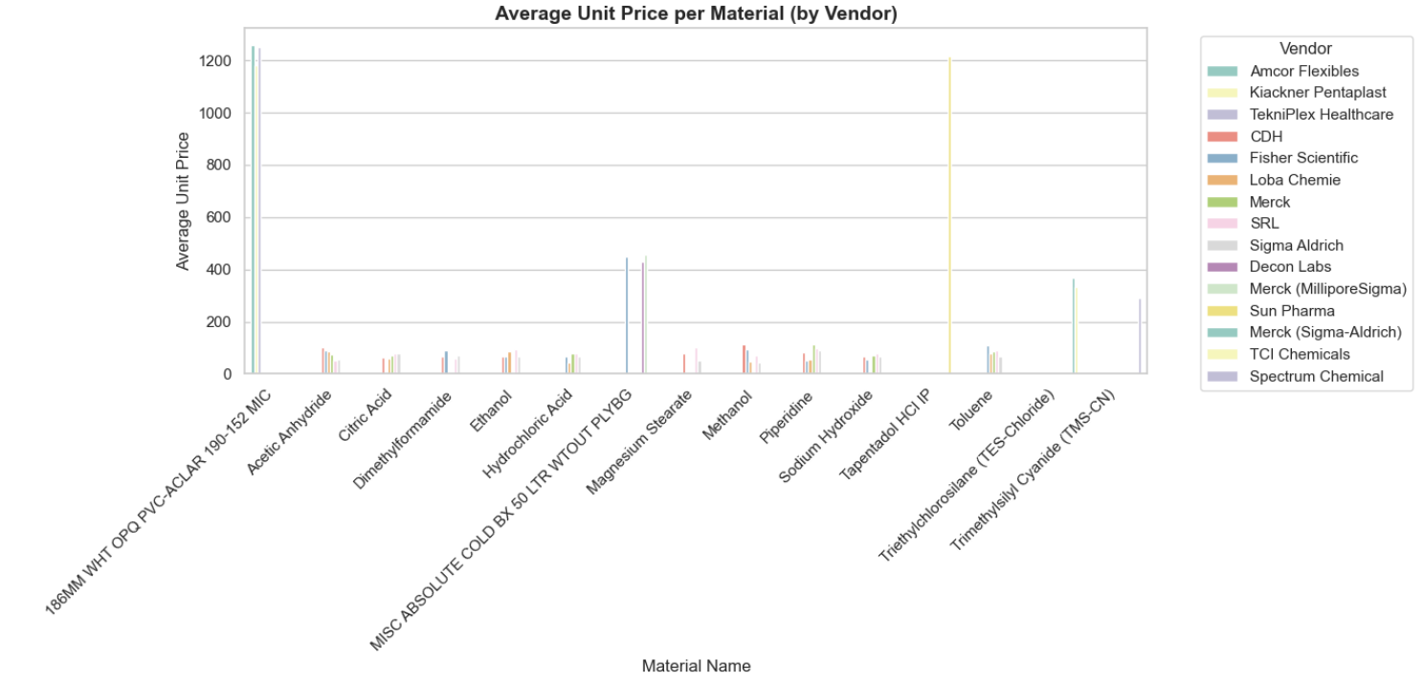
AVERAGE LATEST UNIT PRICE PER MATERIAL(by vendor)
High Price Outliers – Materials like 186MM WHT OPO PVC-ACLAR and Toluene stand out with very high unit prices.
Vendor Price Gaps – The same material has noticeably different prices across vendors (e.g., Magnesium Stearate).
Commodity Chemicals – Common chemicals (Ethanol, Citric Acid, NaOH, HCl) show lower, more consistent prices across suppliers.

Slide 3
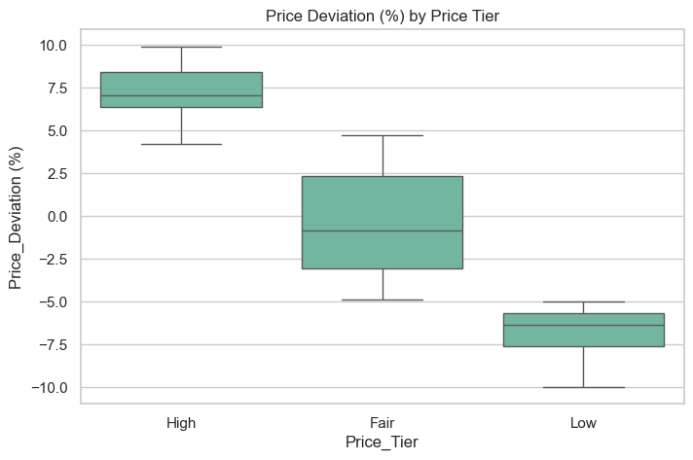
PRICE DEVIATION (%) BY PRICE TIER
High Tier – Prices in this tier deviate positively, mostly +6% to +9%, meaning they’re generally higher than benchmarks.
Fair Tier – Has a wide spread, covering both negative and positive deviations (approx. −5% to +5%), showing mixed alignment with benchmarks.
Low Tier – Strongly negative deviations (−10% to −5%), meaning these materials are consistently cheaper than benchmarks.

Slide 4
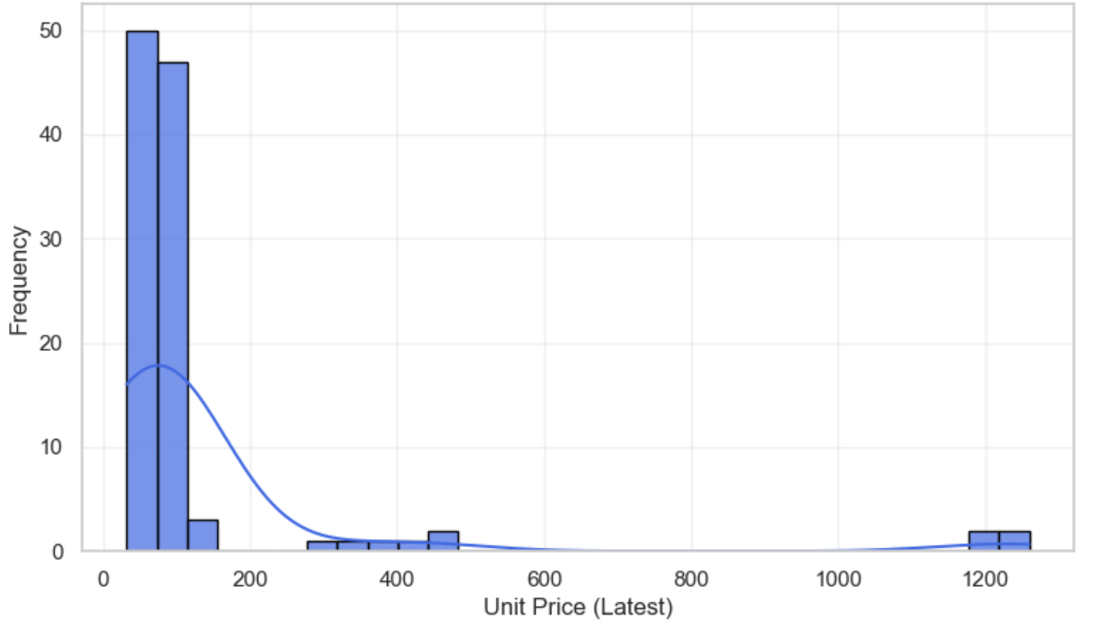
DISTRIBUTION OF LATEST UNIT PRICES
The distribution shows a clear concentration of materials with unit prices under 100, indicating most purchases are relatively low-cost.
There are a few significant outliers with very high unit prices around 1200, suggesting the presence of some expensive specialty materials.
The long right tail and sparse distribution at higher prices reflect price volatility and a mix of both low- and high-cost materials in the procurement portfolio.

Slide 5
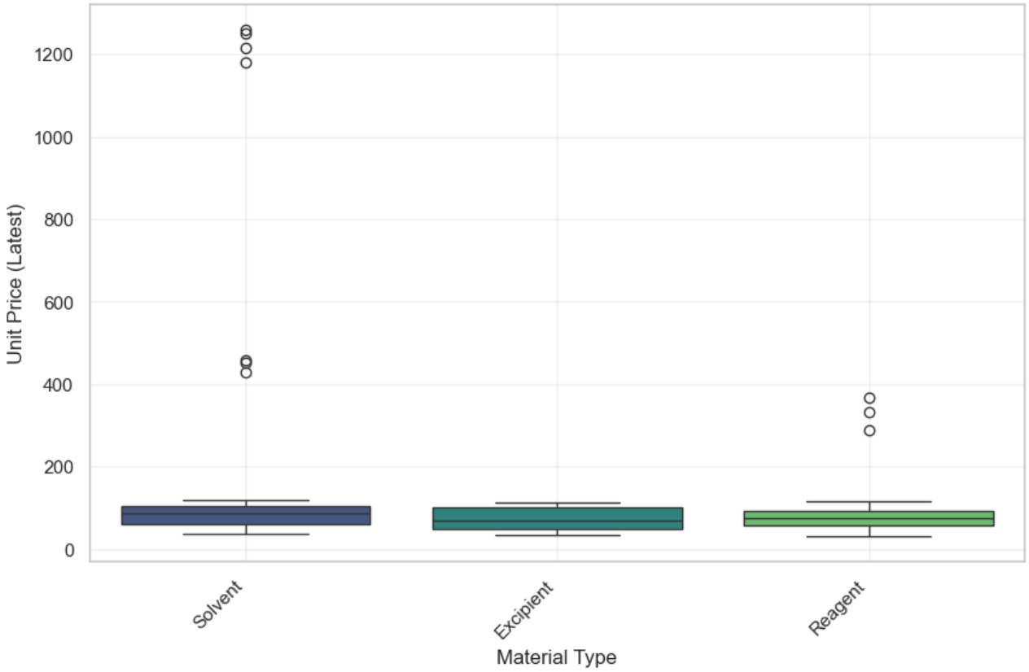
UNIT PRICE DISTRIBUTION BY MATERIAL TYPE
All three material types have most unit prices clustered roughly between 40 and 120, indicating this is the typical price range.
Solvents show several significant high-price outliers, with some prices reaching above 1200, indicating rare but very expensive solvent purchases.
Excipients and Reagents also have outliers but less extreme; Reagents have a few higher-priced materials around 300–400, while Excipients show fewer and less extreme outliers.

Slide 6
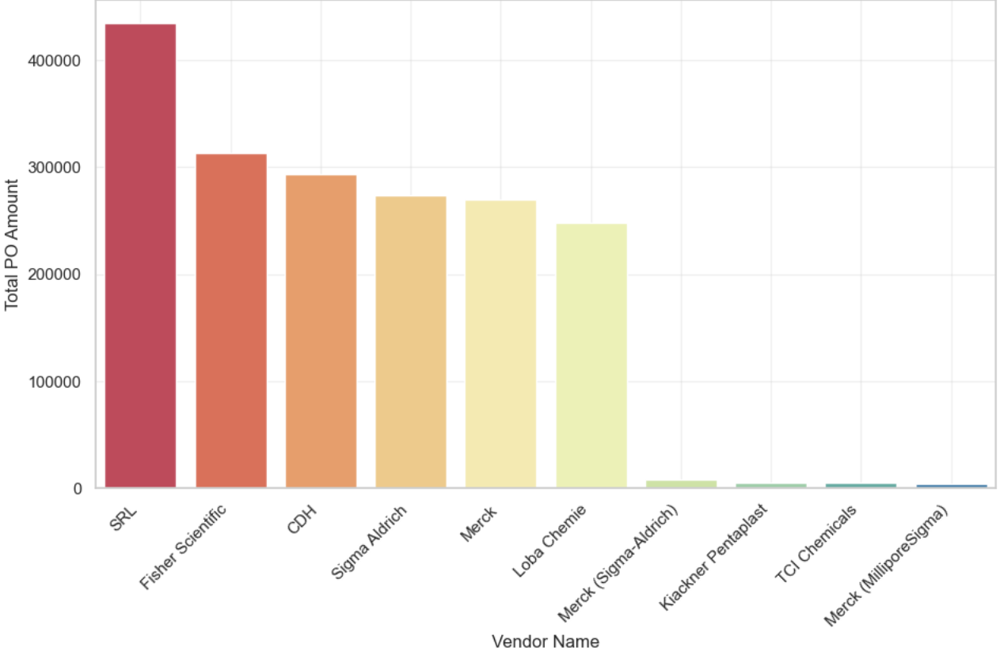
TOP 10 VENDORS BY PURCHASE ORDER AMOUNT
.
SRL is the top vendor with the highest PO spend (> ₹420,000).
Fisher Scientific, CDH, Sigma Aldrich, and Merck follow closely, each around ₹260,000–320,000.
Top 5 vendors contribute over 80% of total spend, showing high vendor concentration.
Other vendors contribute minimal spend (< ₹20,000), likely for niche or backup supply

Slide 7
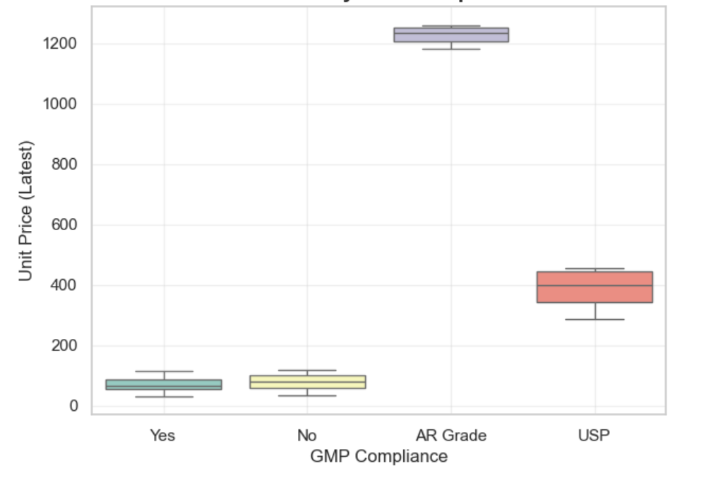
UNIT PRICE BY GMP COMPLIANCE
AR Grade is the costliest: Materials with AR Grade have the highest unit prices, mostly clustered between 1200–1250, which is significantly higher than all other categories. This reflects their high purity and lab-grade use, driving costs up.
USP is moderately priced: The USP grade materials have unit prices ranging roughly between 300–450. This aligns with pharmaceutical use where purity is essential, but costs are lower than AR Grade.
Regular GMP (Yes/No) are the cheapest: Both GMP Yes and GMP No categories show low unit prices, mostly under 120. These are likely standard/commercial grade materials, not requiring high-end compliance

Slide 8
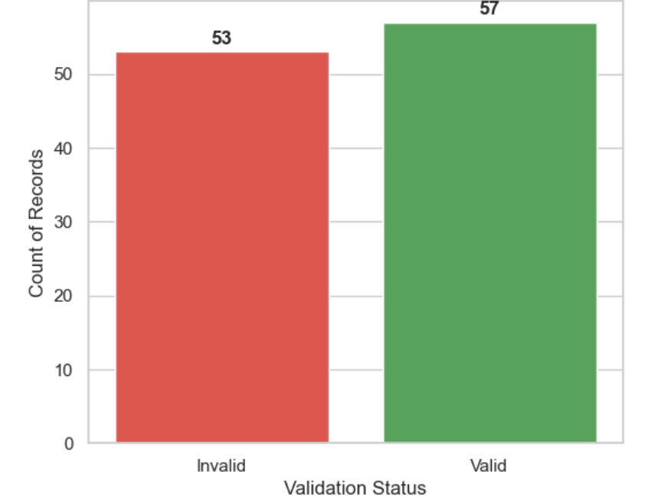
VALID AND INVALID ENTRIES
Balanced Distribution : The dataset contains a near-equal number of valid (57) and invalid (53) records, reflecting an almost 50-50 split.
Slightly More Valid Records : Valid records represent approximately 52% of the total, indicating a slight positive bias toward data correctness.
Data Quality Concern : However, with 48% of records being invalid, there is a notable risk to data reliability, emphasizing the need for thorough data validation and cleansing efforts to enhance overall quality.

Slide 9
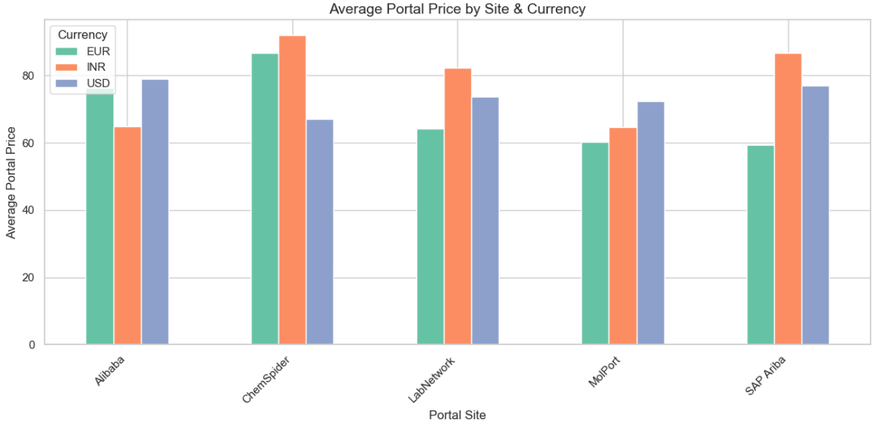
AVERAGE PORTAL PRICE BY SITE & CURRENCY
ChemSpider is the most expensive site – It shows the highest average portal prices across all currencies, especially in INR.
Currency variation is significant – INR prices are generally the highest, while USD prices are consistently lower across most sites.
Alibaba & MolPort are relatively cheaper – Their prices remain lower compared to other portals, making them more cost-effective options.

Slide 10
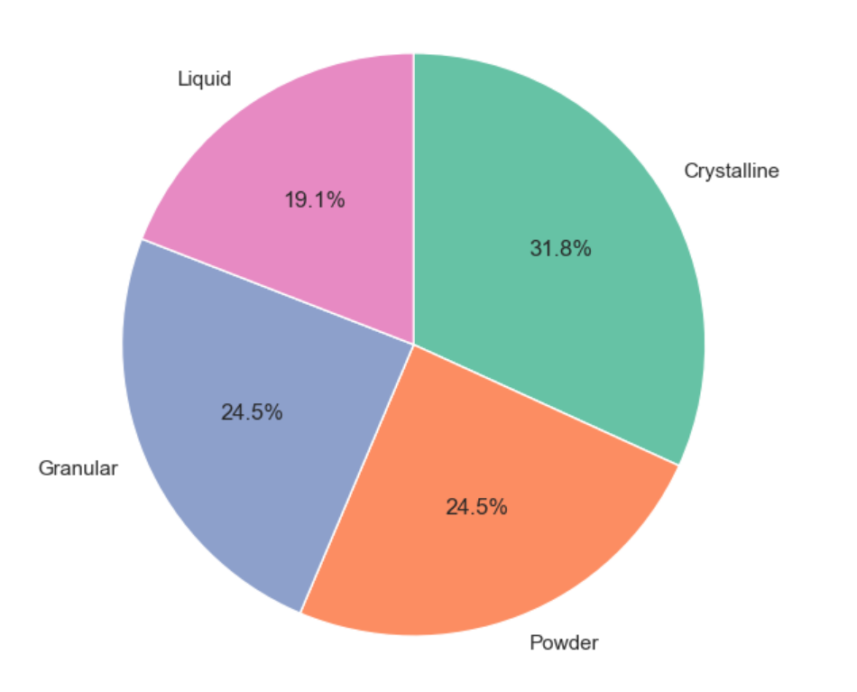
DISTRIBUTION OF MATERIAL FORMS
crystalline form dominates with 31.8%, making it the most common material type used.
Granular and Powder forms are almost equal, each contributing 24.5%, showing balanced usage between these two.
Liquid form is the least represent

